Slide 1
Data Science and Machine Learning
https://github.com/berradais/light-dna-2020-2021

Slide 2
Data is: Big!
Lots of Data => Lots of Analysis => Lots of Jobs
2.5 quintillion (10¹⁸) bytes of data are generated every day!
Everything around you collects/generates data (about 87 % of websites)
Social media sites
Business transactions
Location-based data
Sensors
Digital photos, videos
Consumer behavior (online and store transactions)
More data is publicly available
Database technology is advancing
Cloud based & mobile applications are widespread
Source: IBM http://www-01.ibm.com/software/data/bigdata/

Slide 3
If I have data, I will know :)
Everyone wants better predictability, forecasting, customer satisfaction, market differentiation, prevention, great user experience, ...
How can I price a particular product?
What can I recommend online customers to buy after buying X, Y or Z?
How can we discover market segments? group customers into market segments?
What customer will buy in the upcoming holiday season? (what to stock?)
What is the price point for customer retention for subscriptions?

Slide 4
Data Science is: making sense of Data
Lots of Data => Lots of Analysis => Lots of Jobs
Multidisciplinary study of data collections for analysis, prediction, learning and prevention.
Utilized in a wide variety of industries.
Involves both structured or unstructured data sources.

Slide 5
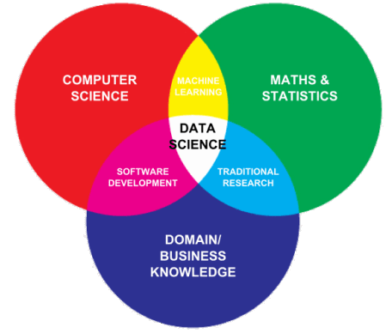
Data Science is: multidisciplinary
Statisticians
Mathematicians
Computer Scientists in
Data mining
Artificial Intelligence & Machine Learning
Systems Development and Integration
Database development
Analytics
Domain Experts
Medical experts
Geneticists
Finance, Business, Economy experts
etc.

Slide 6
Data Science is: about the whole processing pipeline to extract information out of data
Data Scientist understand and care about the whole data pipeline:
A data pipeline consists of 3 steps:
Preparing to run a model: Gathering, cleaning, integrating, restructuring, transforming, loading, filtering, deleting, combining, merging, verifying, extracting, shaping
Running the model
Communicating the results

Slide 7
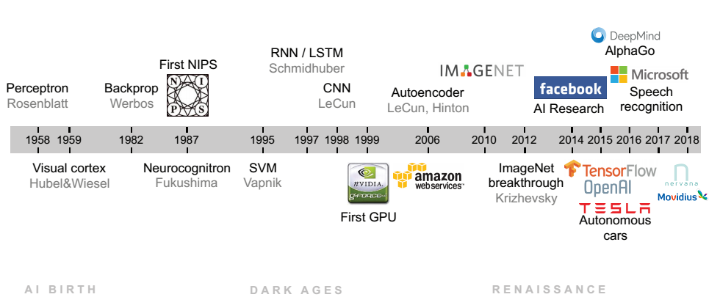
AI
LeCun et all. SIAM 2018

Slide 8

AI zoo

Slide 9


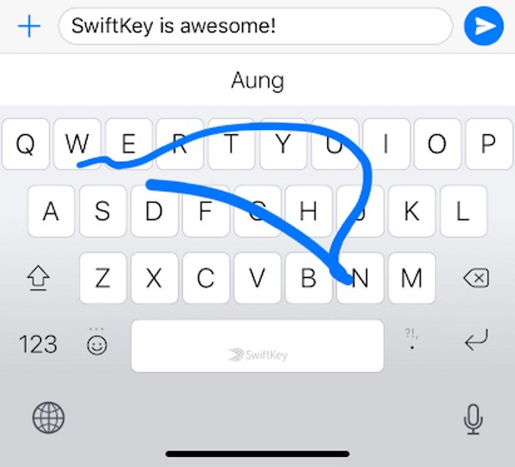
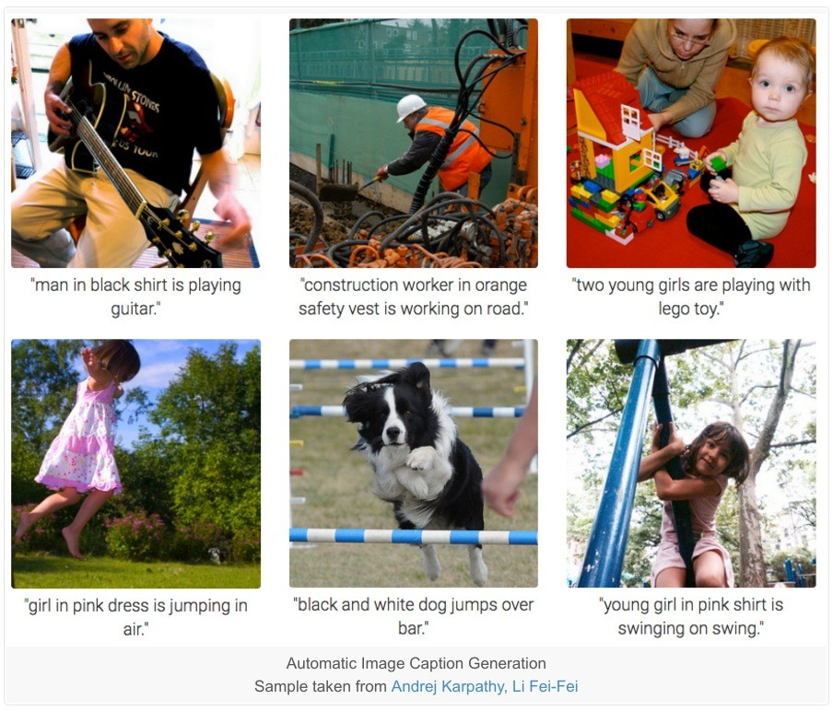
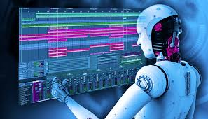

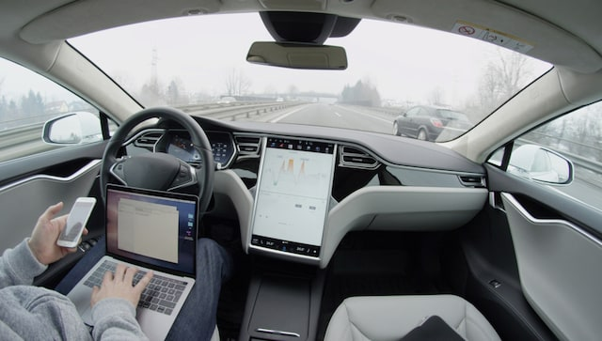




Data Science Success

Slide 10

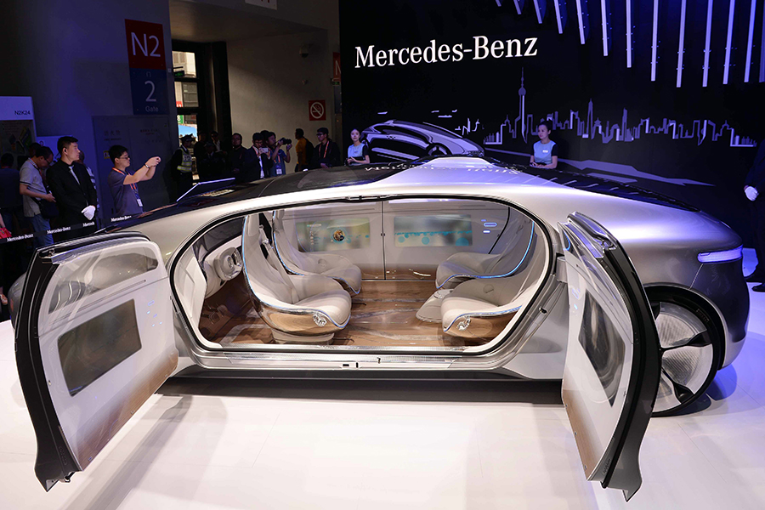
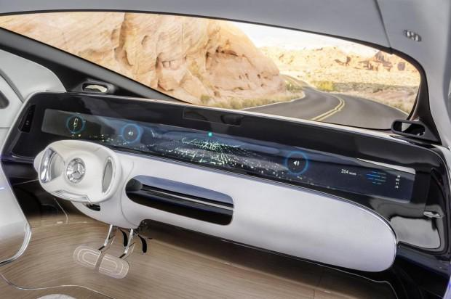
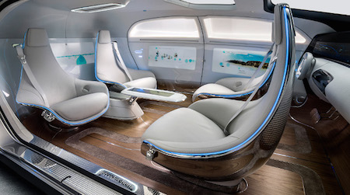

Mercedes-Benz Autonomous Car Interior Concept (Luxury F 015)
Notes:
Bandes dessinée ou dans les films science fiction : on conduit plut mais on discute et on partage et on prend du cafe

Slide 11

“We really designed the Model S to be a very sophisticated computer on wheels. Tesla is a software company as much as it is a hardware company. A huge part of what Tesla is, is a Silicon Valley software company. We view this the same as updating your phone or your laptop.”
“Full autonomy is really a software limitation: The hardware exists to create full autonomy, so it’s really about developing advanced, narrow AI for the car to operate on” Elon Musk

Slide 12
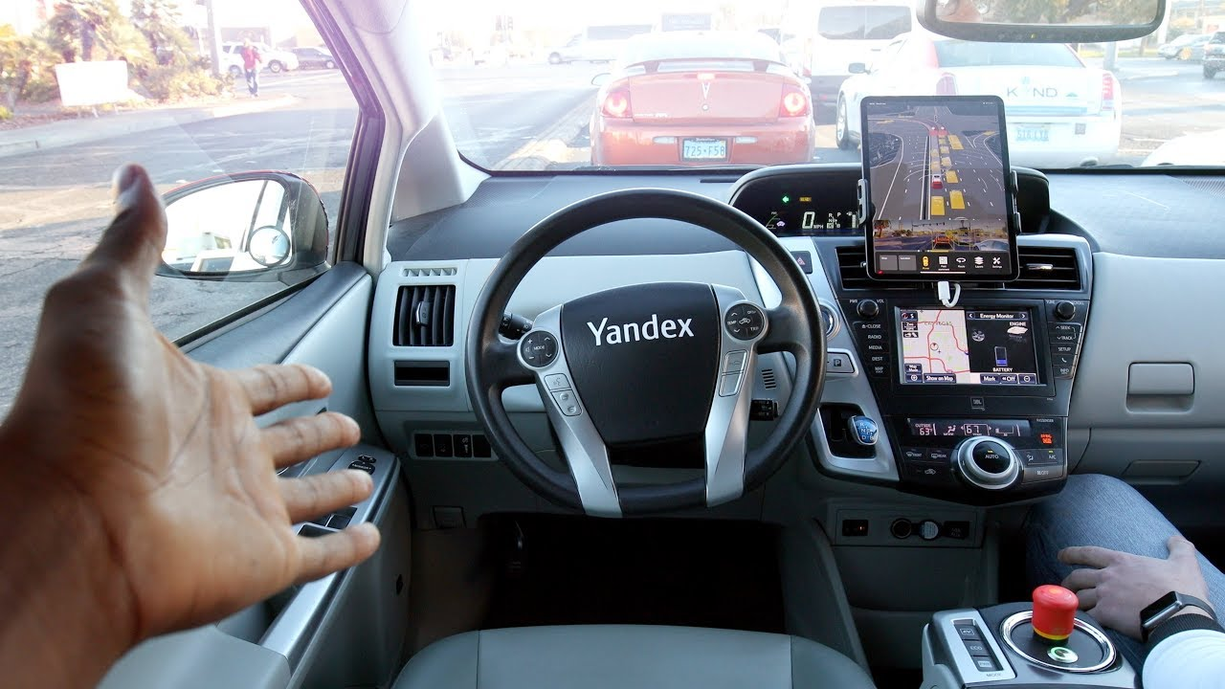
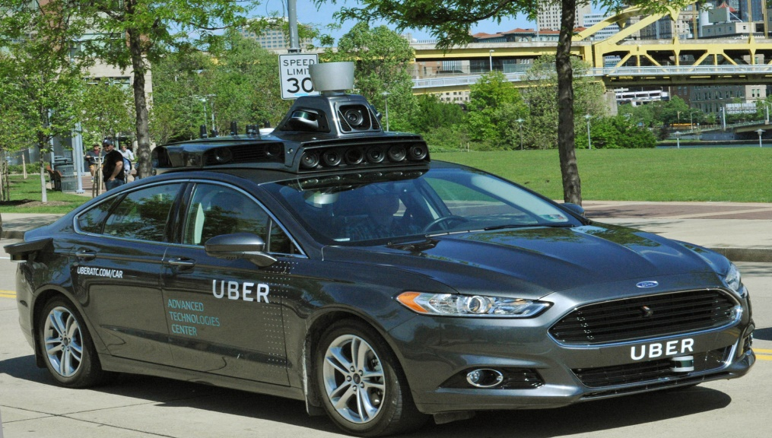
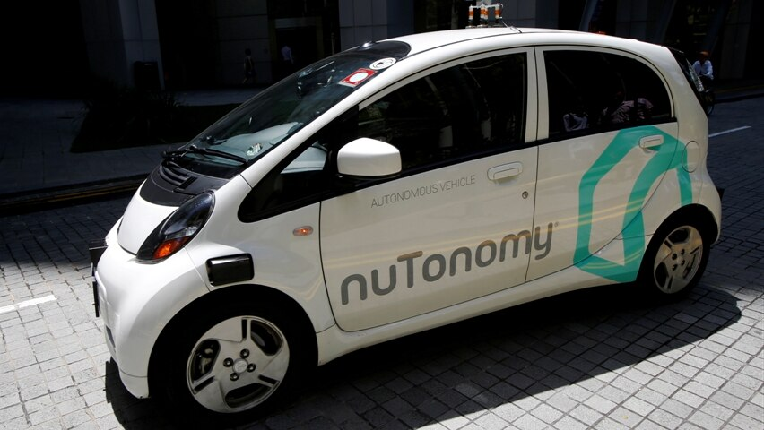



Notes:
Waymo is an autonomous car development company spun out of Google's parent company, Alphabet Inc in december 2016. It then took over the self-driving car project which Google had begun in 2009.
Electric autonomous passenger drone: Boeing, Airbus, China
The 2017 version of their car called the Pacifica minivan as shown in the figure and considered the most advanced self-driving car to date.
You may ask why, well apparently, Google toke good care training those new prototypes, in fact they were trained over roughly 3 million miles of real-world driving using data gathered from their own sensors , and in the last year alone they’ve completed one billion miles of testing in simulation.
To reach what the Society of Automotive Engineers classify as Level 4 autonomy , they built all of their self-driving sensors from the ground up, which not only made their prototype safer and reliable, but considerably cheaper, we’re talking about going from 75k to 7,5k per sensor only in LiDAR case. It still a high cost, but much better than before

Slide 13
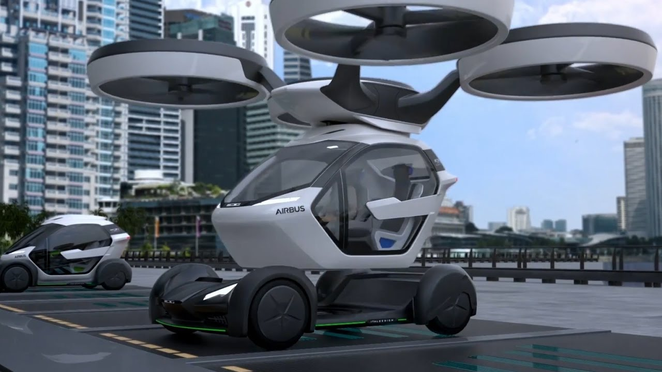


Slide 14
Data Science Principals
Data Science is a process
ML is optimization of loss functions
ML must generalize to unseen data
Evaluate data science in its operational context
Similar entities can have similar unseen attributes
Correlation, not causation
Notes:
https://retro.studydrive.net/de/flashcards/introduction-to-data-science/19368

Slide 15
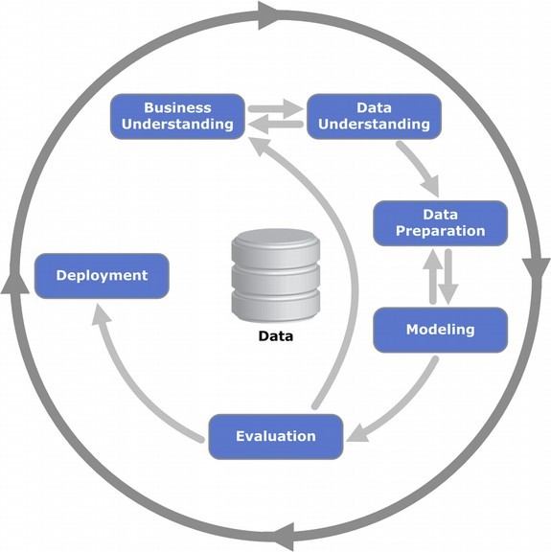
P1: Data Science is a process
Cross-industry standard process for data mining, known as CRISP-DM, is an open standard process model that describes common approaches used by data mining experts.
It is the most widely-used analytics model
Notes:
Cross-industry standard process for data mining, known as CRISP-DM,^{[1]} is an open standard process model that describes common approaches used by data mining experts. It is the most widely-used analytics model.^{[2]}
In 2015, IBM released a new methodology called Analytics Solutions Unified Method for Data Mining/Predictive Analytics^{[3]} ^{[4]} (also known as ASUM-DM) which refines and extends CRISP-DM.

Slide 16
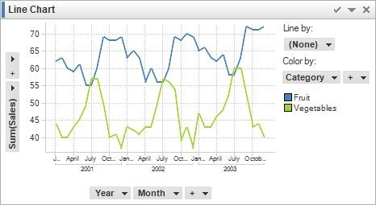
P1: Data Science is a process A simple workflow from a technical PoV
Plan
Clean Data
What is the question?
Data Quality Analysis
Reformating & Imputing Data
Start
Data Acquisition
What type of data is needed?
Scripts
Explore the Data
Feature
Deployment
Feature Selection
Model Selection
Results Evaluation
Maintenance
Engineering
Scripts
Optimization
Scripts
Data Analysis
Modeling
Deployment and optimization
Notes:
Feature engineering is the process of using domain knowledge to extract features from raw data via data mining techniques.

Slide 17
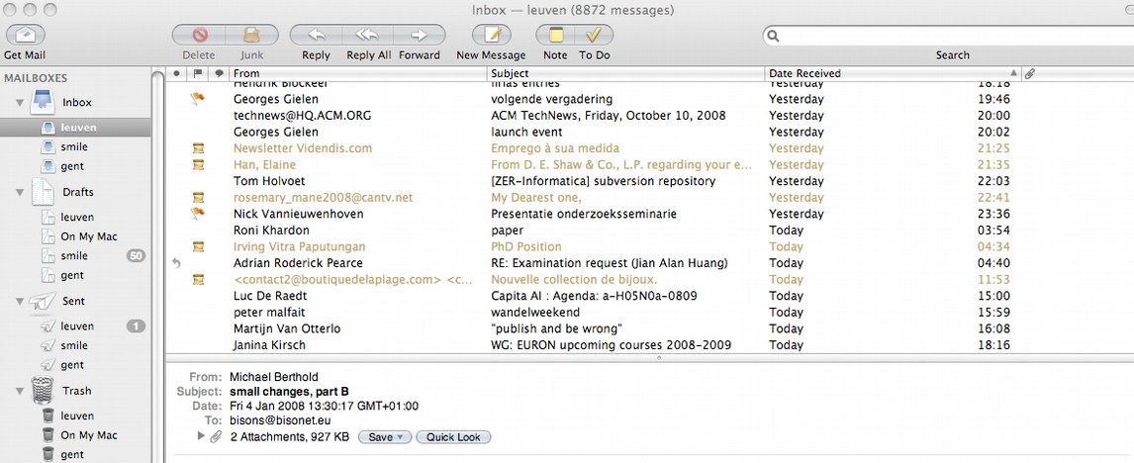
P1: Data Science is a process A simple workflow
Business understanding
SPAM email reduces productivity, automatically remove it

Slide 18
P1: Data Science is a process A simple workflow
Data understanding
Collect messages, in general and from the user, that are spam (negative) and legitimate (positive): acquisition, annotation, definition of the targer, …
Given a text message, predict whether it is spam or not
→ text categorization, useful in general
→ we want a function from message to {0,1}
→ is called binary classification problem
Notes:
ext categorization (a.k.a. text classification) is the task of assigning predefined categories to free-text documents. It can provide conceptual views of document collections and has important applications in the real world. For example, news stories are typically organized by subject categories (topics) or geographical codes; academic papers are often classified by technical domains and sub-domains; patient reports in health-care organizations are often indexed from multiple aspects, using taxonomies of disease categories, types of surgical procedures, insurance reimbursement codes and so on. Another widespread application of text categorization is spam filtering, where email messages are classified into the two categories of spam and non-spam, respectively.

Slide 19
P1: Data Science is a process A simple workflow
Data preparation
Given a raw text, convert string data into numerical data one
· Bag of words, TFIDF, Word2Vec
Text Preprocessing
Remove Noisy Data: header, footer, HTML, XML, markup data
Tokenization: word, character, and subword (n-gram characters)
Normalization: converting all words to lowercases, …
Notes:
A bag-of-words is a representation of text that describes the occurrence of words within a document. It involves two things: A vocabulary of known words. A measure of the presence of known words
- tf–idf or TFIDF, short for term frequency–inverse document frequency, is a numerical statistic that is intended to reflect how important a word is to a document in a collection or corpus.^{[1]} It is often used as a weighting factor in searches of information retrieval, text mining, and user modeling. The tf–idf value increases proportionally to the number of times a word appears in the document

Slide 20
P1: Data Science is a process A simple workflow
Modeling
We could write a rule-based system, such as
if Title.contains(“YOU HAVE WON!!!”) then return Spam
train a classifier (e.g. naïve bayes, tree-based)
Does it work well? → evaluate

Slide 21
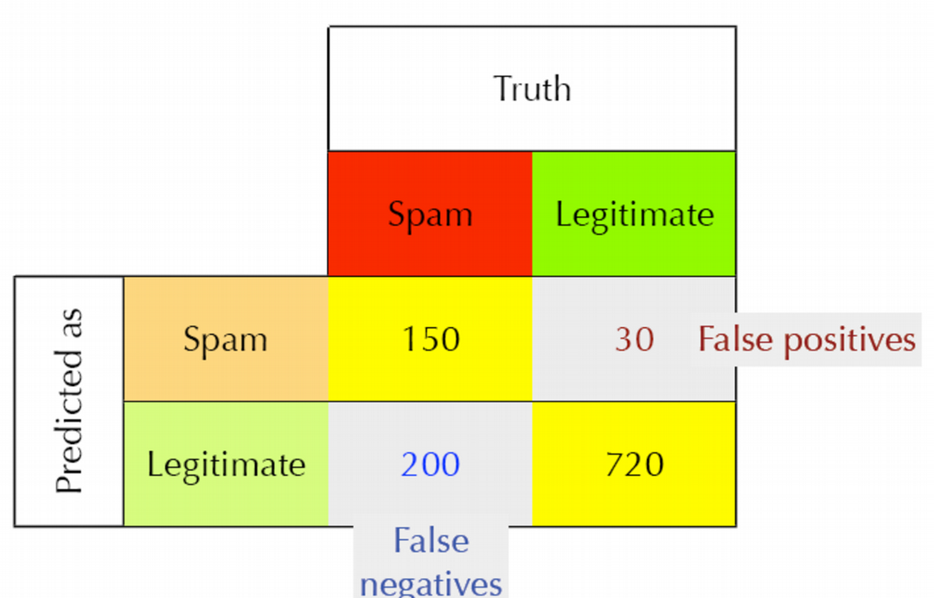
P1: Data Science is a process A simple workflow
Evaluation
on unseen emails

Slide 22
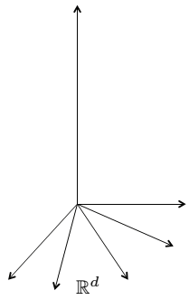
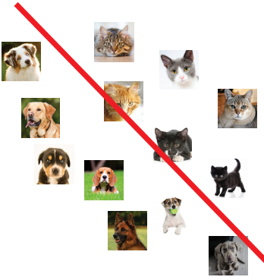
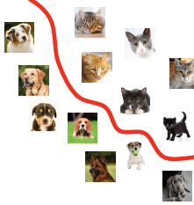
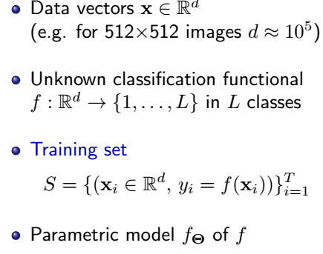
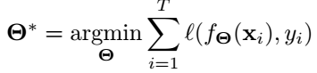
P2: Machine learning is optimization

Slide 23
P2: Machine learning is optimization
when using AI heuristics to find some optimum, you may end up in a local maximum

Slide 24
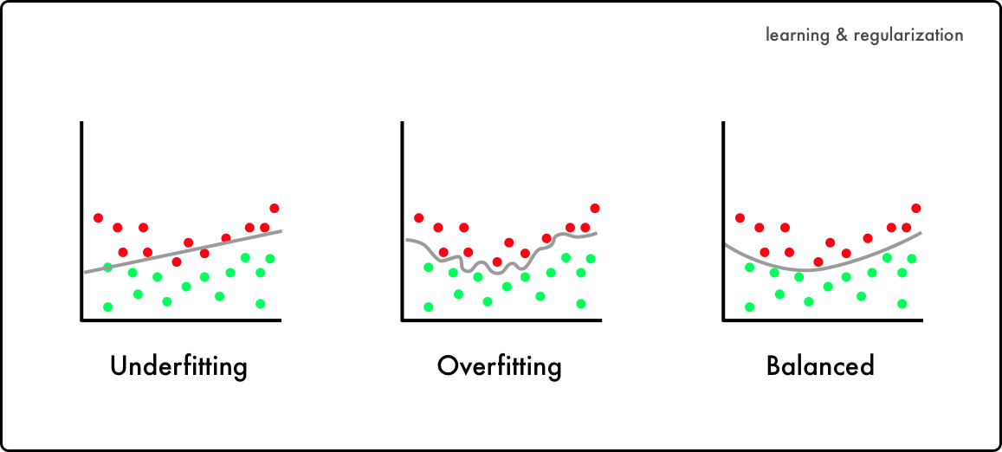
P2: Generalizing
If you look too hard at a dataset, you will find something, but it might not generalize beyond the data you're looking at (unseen data) = Overfitting

Slide 25
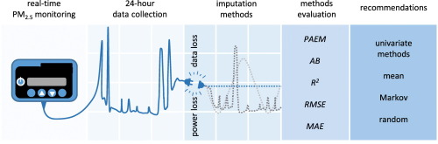
P3: Missing information
The impact of missing data on quantitative research can be serious, leading to biased estimates of parameters, loss of information, decreased statistical power, increased standard errors, and weakened generalizability of findings.
multiple imputation, maximum likelihood, and expectation-maximization algorithm

Slide 26
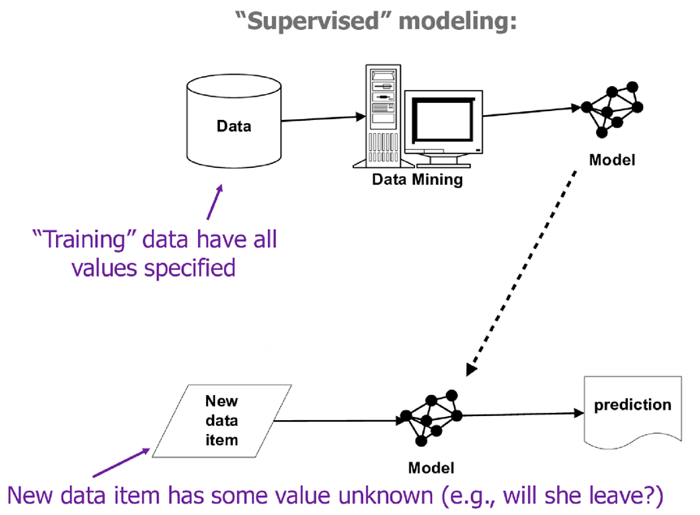
P4: Data science needs to be evaluated in the context of operation
Training data is not consistent with actual use
Bad samples
Bad features

Slide 27
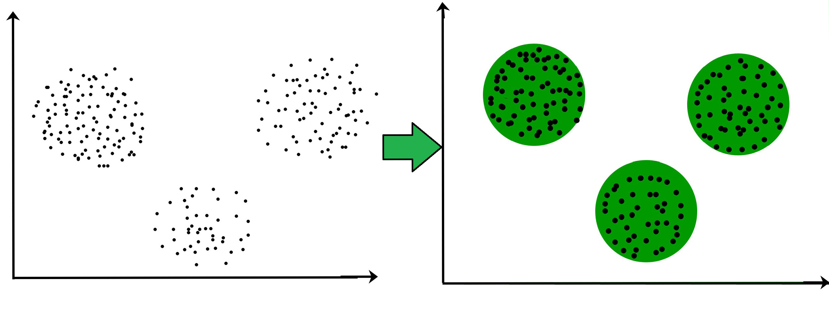
P5: Entities that are similar on some attributes often are similar on unseen attributes (causality)
Clustering
Also optimization, e.g. min. distances to cluster center
Key concept: distance between objects
Euclidean, Manhattan, edit distances (strings), Dynamic time warping (temporal sequences), …
Notes:
In time series analysis, dynamic time warping (DTW) is one of the algorithms for measuring similarity between two temporal sequences, which may vary in speed.

Slide 28
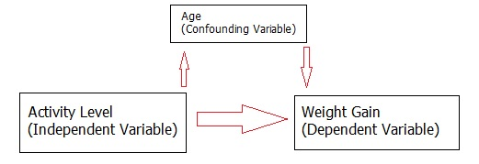
P6: Correlation
To draw causal conclusions, one must pay very close attention to the presence of (possibly unseen) confounding factors
Machine models exploit correlation, NOT causality
Very tempting to inspect model and see “what causes things to be true/false”
E.g. coefficients of linear regression
Y = 20*X1 –12*X2 +300*X3 +99*X4 -299*X5
Which feature has most impact?
Notes:
A confounding factor in a study is a variable which is related to one or more of the variables defined in a study. A confounding factor may mask an actual association or falsely demonstrate an apparent association between the study variables where no real association between them exists. If confounding factors are not measured and considered, bias may result in the conclusion of the study.
A confounding variable is an “extra” variable that you didn’t account for. They can ruin an experiment and give you useless results. They can suggest there is correlation when in fact there isn’t. They can even introduce bias. That’s why it’s important to know what one is, and how to avoid getting them into your experiment in the first place.
In an experiment, the independent variable typically has an effect on your dependent variable. For example, if you are researching whether lack of exercise leads to weight gain, then lack of exercise is your independent variable and weight gain is your dependent variable. Confounding variables are any other variable that also has an effect on your dependent variable. They are like extra independent variables that are having a hidden effect on your dependent variables. Confounding variables can cause two major problems:
Increase variance
Introduce bias.
Let’s say you test 200 volunteers (100 men and 100 women). You find that lack of exercise leads to weight gain. One problem with your experiment is that is lacks any control variables. For example, the use of placebos, or random assignment to groups. So you really can’t say for sure whether lack of exercise leads to weight gain. One confounding variable is how much people eat. It’s also possible that men eat more than women; this could also make sex a confounding variable. Nothing was mentioned about starting weight, occupation or age either. A poor study design like this could lead to bias. For example, if all of the women in the study were middle-aged, and all of the men were aged 16, age would have a direct effect on weight gain. That makes age a confounding variable.
In LR, The magnitude of the coefficients depends directly on the scales selected for the variables, which is a somewhat arbitrary modeling decision.

Slide 29
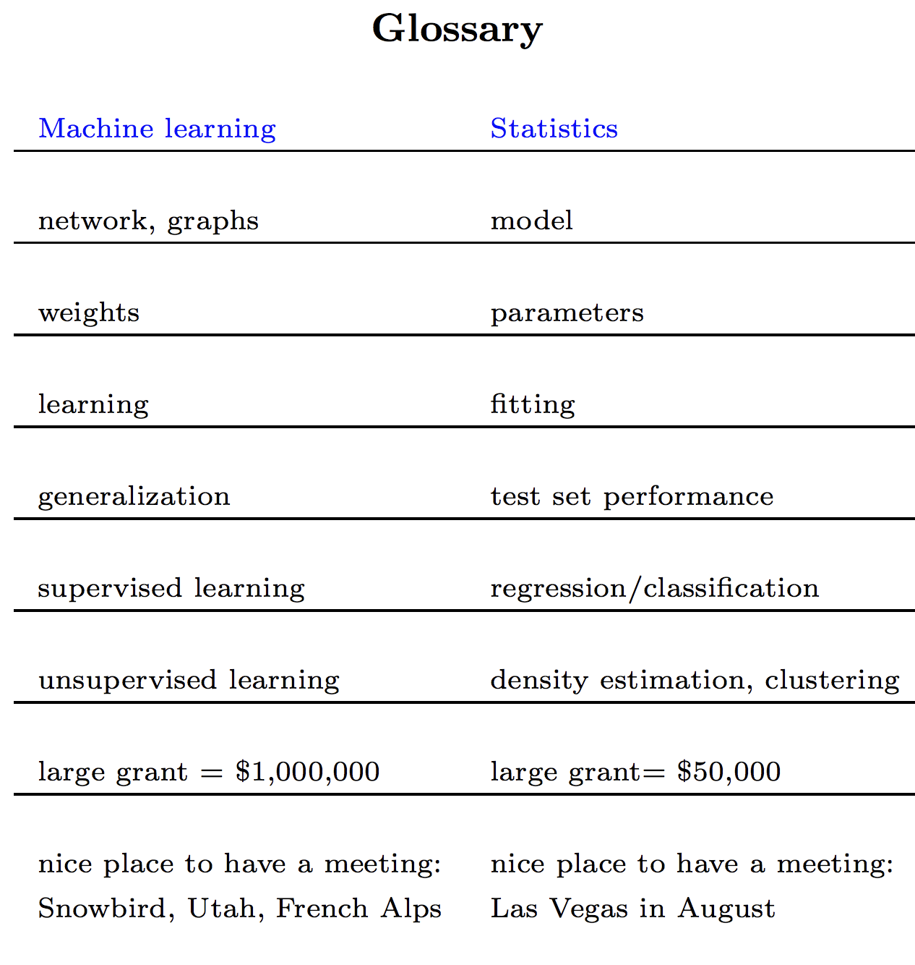
ML vs Stat
In his course on statistics, Rob Tibshirani, a statistician who also has a foot in machine learning, provides a glossary that maps terms in statistics to terms in machine learning, reproduced below.

Slide 30
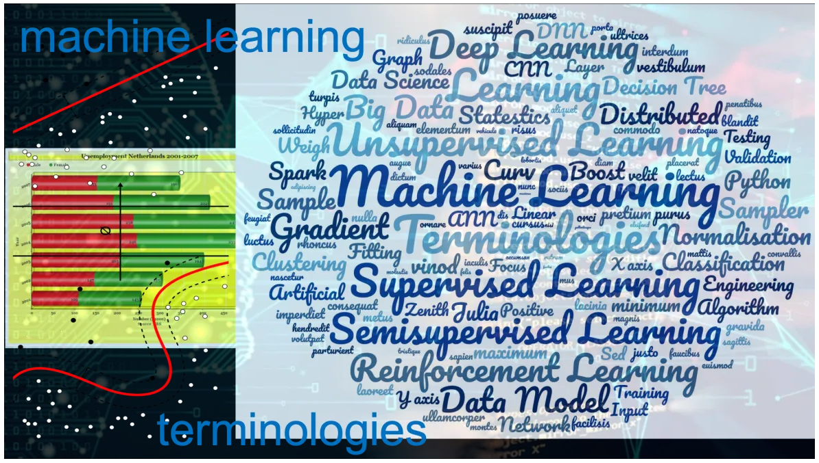
ML terminology

Slide 31
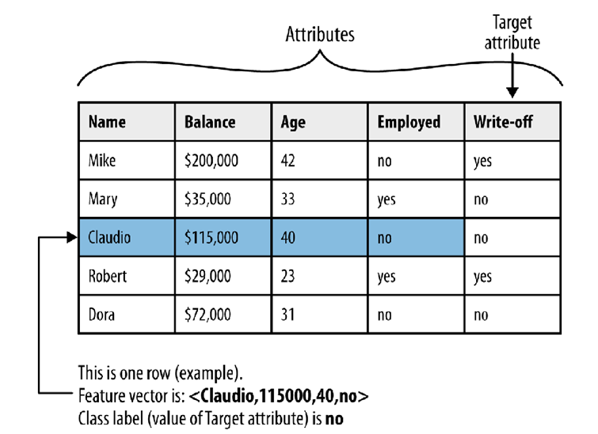
ML Terminology

Slide 32
ML Terminology
Attribute (field, variable, feature)
A quantity describing an instance. An attribute has a domain defined by the attribute type, which denotes the values that can be taken by an attribute. The following domain types are common:
Categorical: A finite number of discrete values. The type nominal denotes that there is no ordering between the values, such as last names and colors. The type ordinal denotes that there is an ordering, such as in an attribute taking on the values low, medium, or high.
Continuous (quantitative): Commonly, subset of real numbers, where there is a measurable difference between the possible values. Integers are usually treated as continuous in practical problems.

Slide 33
ML Terminology
A feature is the specification of an attribute and its value.
For example, color is an attribute. ``Color is blue'' is a feature of an example.
Many transformations to the attribute set leave the feature set unchanged (for example, regrouping attribute values or transforming multi-valued attributes to binary attributes).
Some authors use feature as a synonym for attribute (e.g., in feature-subset selection).
Data set: A schema and a set of instances matching the schema. Generally, no ordering on instances is assumed. Most machine learning work uses a single fixed-format table.

Slide 34
ML Terminology
Instance (example, case, record): A single object of the world from which a model will be learned, or on which a model will be used (e.g., for prediction). In most machine learning work, instances are described by feature vectors; some work uses more complex representations (e.g., containing relations between instances or between parts of instances).

Slide 35
Data preparation problem
The Problem with Data Science
Most organizations still face a data scientist bottleneck.
People want to do data science, they want to use machine learning models in production, but they can’t achieve this because they don’t have the required resources.
While colleges and others try to create as many data scientists as possible, it’s just not happening fast enough and it’s hard to hire them.
The potential solution comes with two different flavors
The first flavor – let’s empower more people to do the work data scientists do. So, that means we need to make this a little bit simpler because data science, in general, and machine learning is just too hard. If data preparation is such an important part of data science, we need to make that simpler as well.
The other flavor – let’s make sure that the resources we currently have, or we are going to hire in the future, are more productive.
So now, how does data preparation play an important role here?
Notes:
https://rapidminer.com/blog/data-prep-time-consuming-tedious/

Slide 36
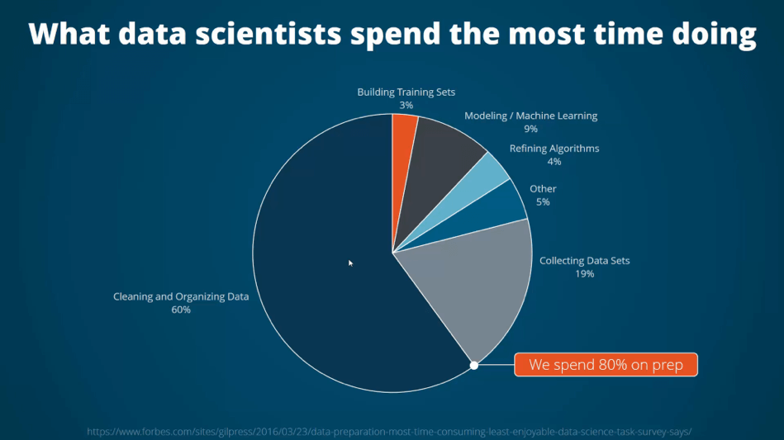
Data preparation problem
What do data scientists spend the most time doing?
We all keep saying that 80% of our work as machine learning experts and data scientists is preparing the data.
So, we spend more than 80% on data preparation. That’s probably because we love it so much, right? Wrong.
Notes:
https://rapidminer.com/blog/data-prep-time-consuming-tedious/

Slide 37
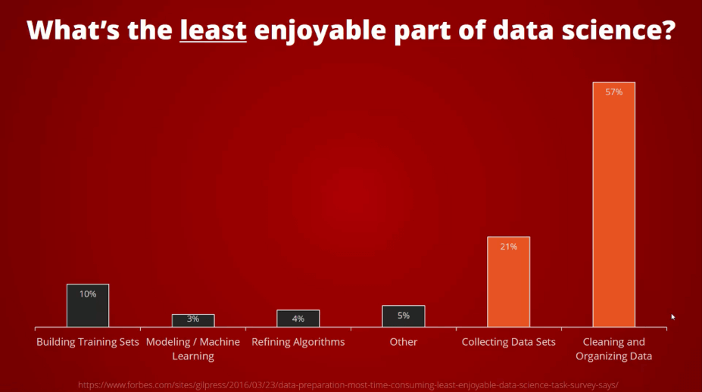
Data preparation problem
What’s the least enjoyable part of data science?
we spend 80% of our time there, and we don’t even enjoy it that much. I mean, that’s horrible, but it’s reality.
57% said it’s cleaning and organizing data
Notes:
https://rapidminer.com/blog/data-prep-time-consuming-tedious/

Slide 38
Data preparation problem
Why data preparation is so important?
Data preparation is a multi-step process that involves data collection, cleaning & preprocessing, feature engineering, and labeling. These steps play an important role in the overall quality of your machine learning model, as they build on each other to ensure a model performs to expectations.
Notes:
https://rapidminer.com/blog/data-prep-time-consuming-tedious/

Slide 39
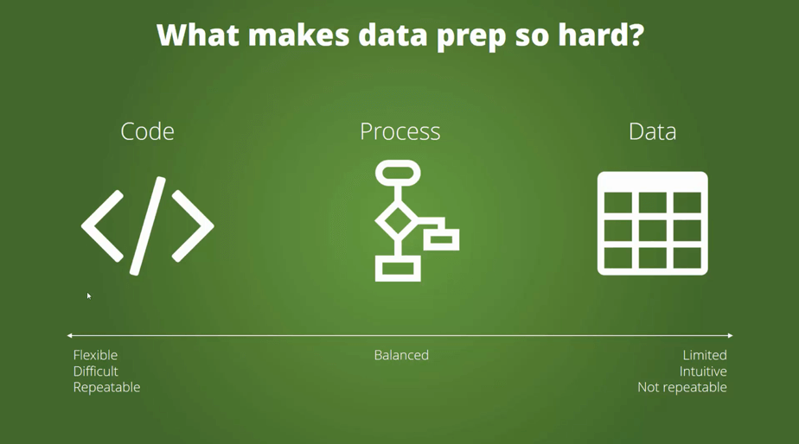
Data preparation problem
What makes data preparation so difficult?
Code-based approach to data science: Python, R
Process-based approach to data science: orange, rapidminer
Data-centric approach to data science: Excel
Notes:
https://rapidminer.com/blog/data-prep-time-consuming-tedious/

Slide 40
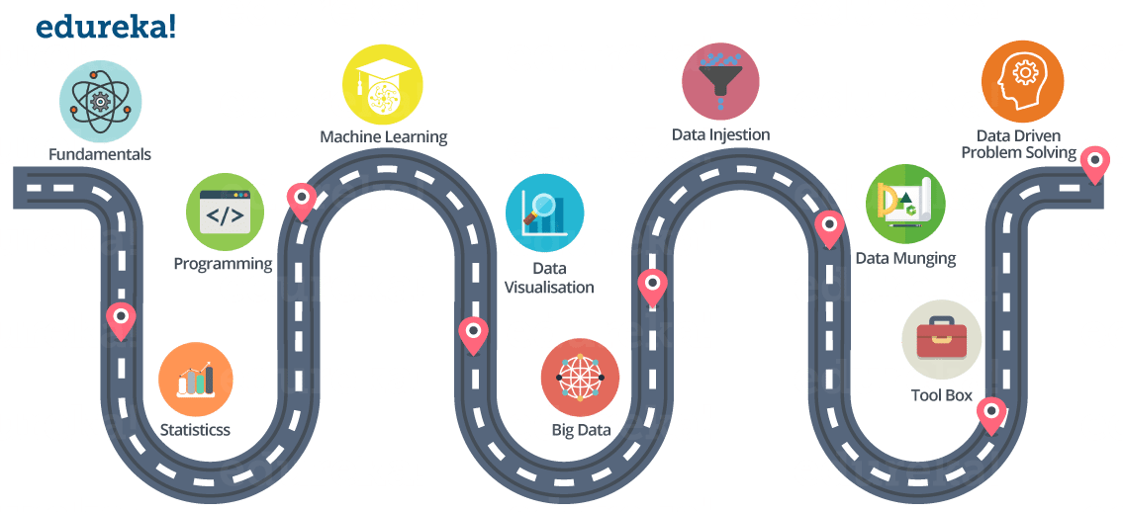
Data preparation problem
The path to be a data scientist
Notes:
https://www.edureka.co/blog/how-to-become-a-data-scientist/
Data munging = Data wrangling, sometimes is the process of transforming and mapping data from one "raw" data form into another format
Data ingestion is the process of obtaining and importing data for immediate use or storage in a database.
Fundamentals: Matrices and Linear Algebra Functions, Reporting VS BI (Business Intelligence) VS Analytics
Statistics: Descriptive Statistics (Mean, Median, Range, Standard Deviation, Variance), Exploratory Data Analysis
Percentiles and Outliers, Probability Theory, Bayes Theorem, Random Variables, Cumulative Distribution function (CDF), Skewness
Other Statistics fundamentals
Programming:
Machine Learning and Advanced Machine Learning (Deep Learning):
Data Visualization: kibana
Big Data: spark
Data Ingestion: The process of importing , transferring , loading and processing data for later use or storage in a database is called Data Ingestion. This involves loading data from a variety of sources. Apache Flume, Apache Sqoop
Data Munging:
If you have ever performed data analysis, you might have come across feature selection before you apply your Analytical model to the data.
So, in general, all the activity that you do on the raw data to make it “clean” enough to input to your analytical algorithm is data munging.
You can use ‘R’ and ‘Python’ packages for that.
Tool Box: You might find this section pretty redundant, but I think it is very very important to have good knowledge on certain tools like:
MS Excel Python or R, Hadoop
Spark, Tableau
Data-Driven Problem Solving:
All the things we have discussed so far, includes tools and technologies that you can learn. But, Data-Driven problem solving approach is something that you need to develop. It will only come with experience.
A Data Scientist needs to know how

